Slide 1
Limestone
Effects of Precipitation

Slide 2
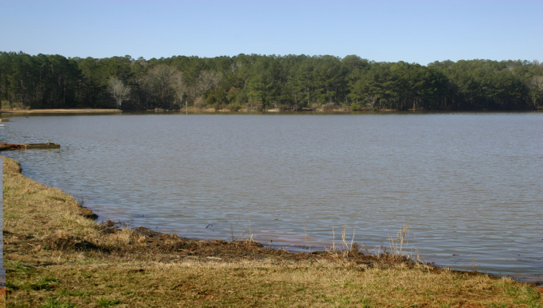
Acid Rain
Acid rain is formed when sulfuric and nitric acid is released into the atmosphere.
The emission of these toxics into the environment is due to human activities.
Therefore, activities such as combustion of engines, industrial combustion, industrial, and agricultural processes release these toxics into the atmosphere.
As a results, acid rain sips into the soil and water bodies to case acidic precipitations on water surfaces.

Slide 3

Effect of Limestone
Acid precipitates on water surfaces react with calcium carbonate anions.
The reaction results in a bicarbonate solution.
As a result, there will be constant levels of H2CO3 on the surface of water.

Slide 4
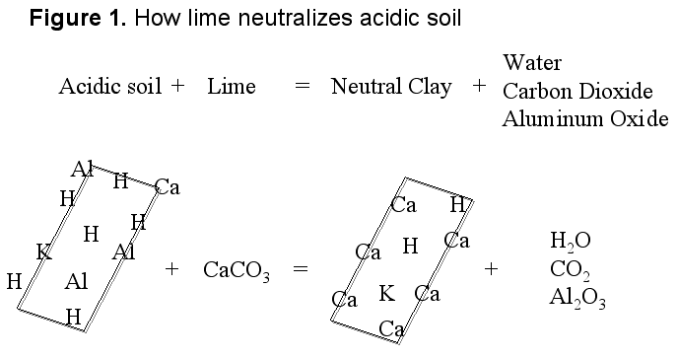
Liming
Limestone (calcium carbonate and calcite ) should be used for the purpose of liming.
These types of lime are inexpensive and readily available.
Liming reduces toxic metals that are dissolved in lakes and streams.
It raises the alkalinity of water, therefore, reducing acidity.
Lakes and streams have soft water that have little buffering capacity.
Lime is applied on the surface of lakes and streams to restore water quality.

Slide 5
How Much Limestone Should be Applied
The most typical application of limestone should range between 1- 2 tons per surface acre (Helfrich, Neves, & Parkhurst, (2019).
Consultants use computer applications and small-scale lab simulations to approximate the limestone levels required on specific treatment site.
There are chemical test kits that can be used to measure acidity and alkalinity levels.
Calculation of limestone needed for a particular areas is based on a number of factors.

Slide 6
Factors Affecting the Level of Limestone Applied
Acidity and lake bottom water chemistry.
Existing pH, hardness, and alkalinity.
Water temperature and quality.
Target water quality (appropriate pH).
Types of aquatic plants available.
Water density.
Purity, type, and particle size of lime.
Flushing and volume rate.

Slide 7
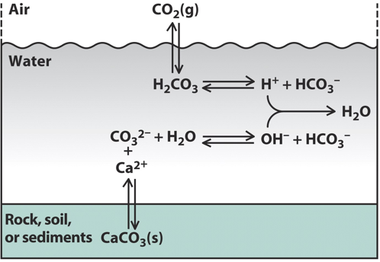
Addition of Buffering Materials to Water Bodies Directly: Methodology
Lime particles are added in lakes and streams with acid precipitates directly.
The lime neutralizes the acids imsmediately,
Therefore, improving the water pH.
The water from the water bodies is titrated using a doser equipment.
Grained limestone is combined with water to form slurry (Clair, 2011).

Slide 8
Cont.
pH measuring sensors are used control the amounts of lime added to the water.
The sensors are located both upstream and downstream..
The number dosers used depend on the type of site.

Slide 9
Advantages and Disadvantages of Using In-Stream Dosing
Advantages:
It helps to target fish populations that are in the lakes or streams.
The pH and calcium levels can be varied consistently to reach optimal levels.
As a result, aquatic species can be protected as well as lime waste will be reduced.
Disadvantages:
The dosing equipment is expensive since it needs continual maintenance.
Dosers needs long-term operation; therefore, it is time-consuming.

Slide 10
Addition of Buffering Materials to Lake/ Stream Sediments
Lime particles (dolomite) are added to stream and lake sediments.
Base citations and bicarbonate particles pass through barriers.
Limitations
Lime can be covered rapidly with organometallic coatings; therefore, reducing its dissolution.
Vigorous lakes and streams often do not have barriers since the bedrock has been shifted downstream (Clair, 2011).

Slide 11
Addition of Buffering Chemicals in Catchment Areas
Buffering compounds are added to water catchment areas using helicopters.
The methodology is an alternative to in-stream and lake liming.
Advantages:
It avoids the tradeoffs of lake water columns mixed poorly.
It is appropriate for detoxifying remote and smaller water bodies that are not easily accessible.
It also require lower maintenance since the lime is not applied frequently.
Complex dosing systems are not required.
It also restores base saturation to initial levels.

Slide 12
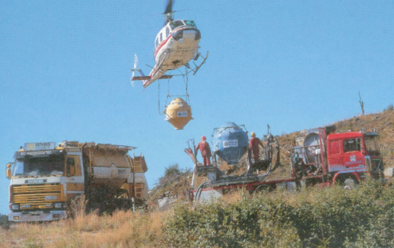
Cont.: Disadvantages
The method is disadvantageous since it requires a high application cost.
The amount of lime required is often based on soil conditions and types.
Also, water flow path and site areas also affect the application of lime.

Slide 13
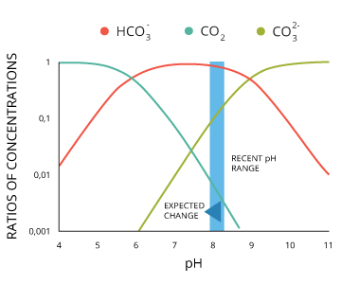
Chemicals Used
The chemical used most often is limestone (calcium carbonate).
Acid precipitation creates strong anions that are partly in equilibrium with aluminum and other metals.
Higher levels of acid in the water causes the release of high amounts of aluminum ions.
Lowering the pH between the range of 4-4.5 reduces the toxicity of aluminum.
Al exist as Al3+in water bodies.
Between 5.0-6.0 pH levels, Al ions are still positively charged.
Between 6-7 pH levels, Al ions are precipitated as amorphous aluminum compounds (Clair, 2011).

Slide 14
References
Clair, A. T. (2011). Liming for the mitigation of acid rain effects in freshwaters: A review of recent results. Environmental Reviews, 1 3(1), 91-128.
Helfrich, A. L., Neves, J. R., & Parkhurst, J. (2019). Liming acidified lakes and ponds. Virginia Cooperative Extension. Retrieved from
https://www.pubs.ext.vt.edu/420/420- 254/420-254.html

